Slide 1
Bell Work 12/2
What was one piece of evidence for Darwin's idea of natural selection?
Objective HB.5A.1: Students will be able to summarize the process of natural selection.

Slide 2
True / False
Evolution is a theory about the origin of life
Evolution is a theory
Evolution was first described by Darwin
Evolution happens in individuals
Evolution is a random process
Evolution and natural selection are interchangeable words.

Slide 3
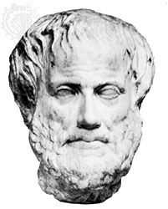
Early Ideas On Earth’s Organisms
Aristotle believed species were fixed creations arranged by their complexity
Idea lasted 2000 years

Slide 4
Thomas Malthus
Noted that humans were being born faster than were dying.
Hypothesized that species have the potential to produce more offspring than can survive.
Darwin used this to help realize that not all offspring survive and reproduce, and later hypothesized that only the “fittest” reproduce and pass on their genes.

Slide 5
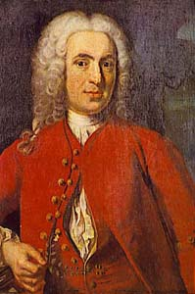
Early Ideas On Earth’s Organisms
Linnaeus – 1st to group similar organisms and assign them Latin names
Two word name (Genus species)
Known as Binomial nomenclature

Slide 6
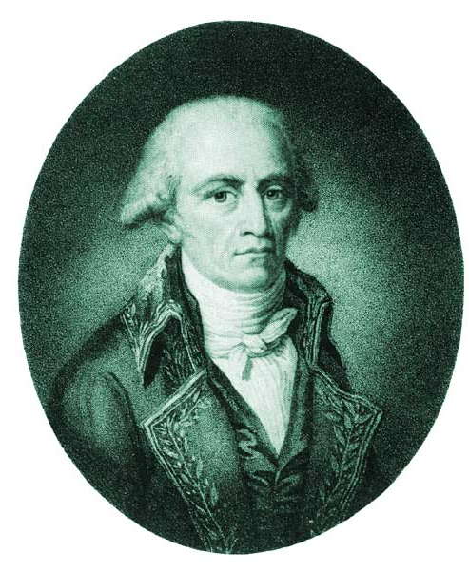
Lamarck’s Theory of Evolution
Jean-Baptiste Lamarck, 1809
One Of First Scientists To Understand That Change Occurs Over Time
Stated that Changes Are Adaptations To Environment acquired in an organism’s lifetime
Said acquired changes were passed to offspring

Slide 7
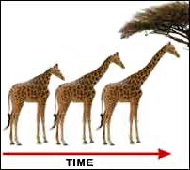
Lamarck’s Theory of Evolution
If a body part were used, it got stronger
If body part NOT used, it deteriorated

Slide 8
Lamarck’s Theory of Evolution
Inheritance of Acquired Characteristics
Proposed That By Selective Use Or Disuse Of Organs, Organisms Acquired Or Lost Certain Traits During Their Lifetime
These Traits Could Then Be Passed On To Their Offspring
Over Time This Led To New Species

Slide 9
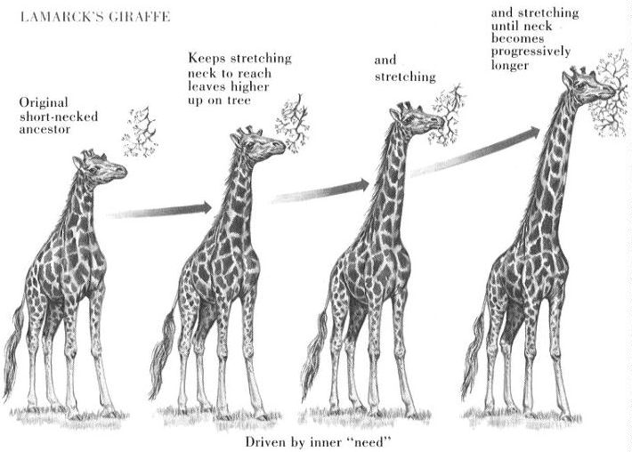

Slide 10
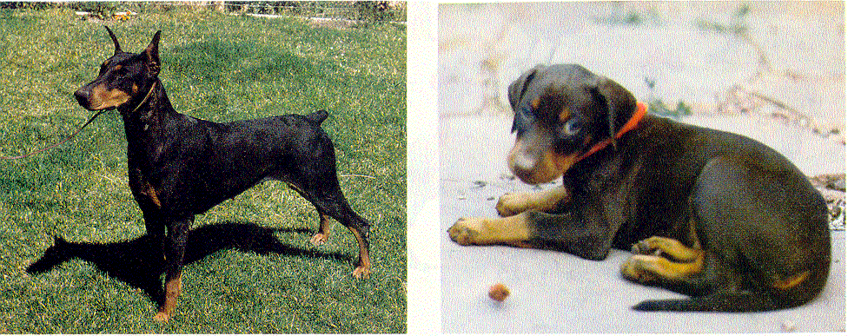
Lamarck’s Theory of Evolution
Inheritance Of Acquired Traits
Traits Acquired During Ones Lifetime Would Be Passed To Offspring
Clipped ears of dogs could be passed to offspring!

Slide 11
Lamarck’s Mistakes
Lamarck Did NOT Know how traits were inherited (Traits are passed through genes)
Genes Are NOT Changed By Activities In Life
Change Through Mutation Occurs Before An Organism Is Born

Slide 12
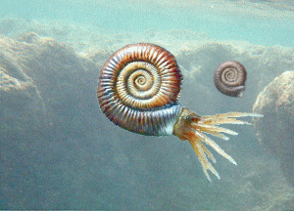
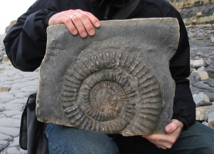
Charles Darwin the Naturalist

Slide 13
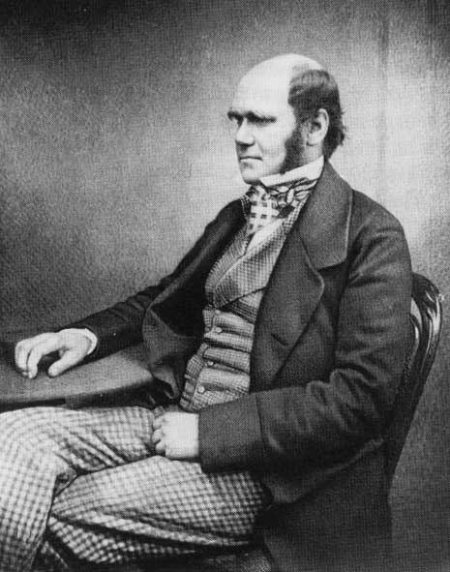
Voyage of the Beagle
Charles Darwin
Born Feb. 12, 1809
Joined Crew of HMS Beagle, 1831
Naturalist
5 Year Voyage around world
Avid Collector of Flora & Fauna
Astounded By Variety of Life

Slide 14
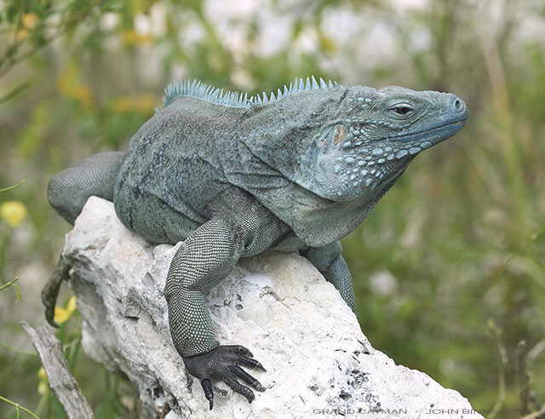
The Galapagos Islands
Small Group of Islands 1000 km West of South America
Very Different Climates
Animals On Islands Unique
Tortoises
Iguanas
Finches

Slide 15
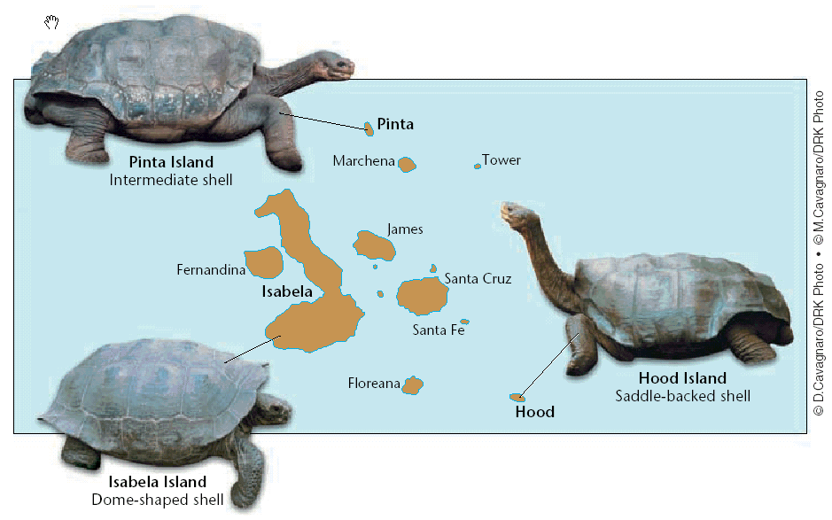

Slide 16
The Galapagos Islands
Finches on the islands resembled a mainland finch
More types of finches appeared on the islands where the available food was different (seeds, nuts, berries, insects…)
Finches had different types of beaks adapted to their type of food gathering

Slide 17
Darwin’s Observations
1. Species Vary Globally
Different, but similar, animals existed around the world.
Ex. Rheas – flightless, ground dwelling birds in south America that look and act a lot like ostriches. In Australia there was the Emu.
He also noticed rabbits and other small creatures from the grasslands in Europe were missing from Australia and South America.
Kangaroos were found nowhere but Australia.

Slide 18
Darwin’s Observations
2. Species Vary Locally- different but related species often occupy different habitats within a local area.
-Locals could identify which island tortoises came from based just on their shell
- He also noticed that small brown birds were present on each island with beaks of different shapes. He thought they were different species of birds at first.

Slide 19
Darwin’s Observations
3. Species Vary over time- he collected fossils too. He noticed some fossils of extinct organisms were similar to present living organisms.
PUTTING IT ALL TOGETHER- He sent his specimens to be studied. The brown birds that he thought were warblers, wrens, and blackbirds were all finches, found nowhere else.
- Same with tortoises and iguanas.

Slide 20
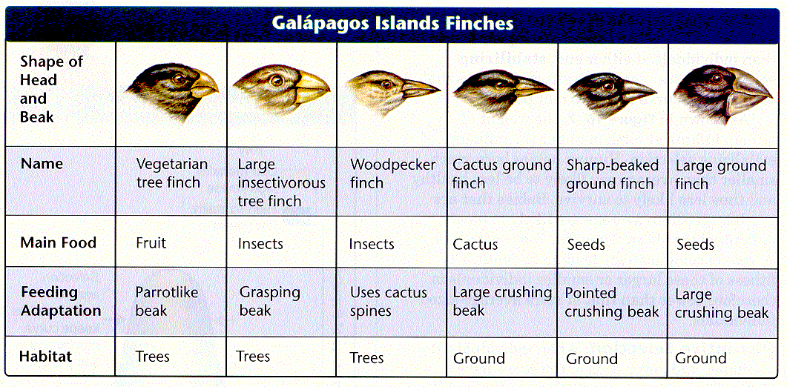

Slide 21
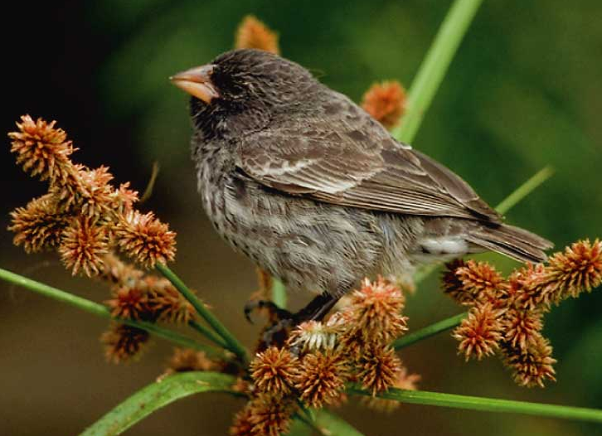
Definition
Evolution is the slow gradual change in a population of organisms over time

Slide 22
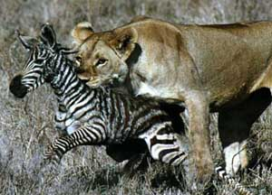
Darwin’s Conclusion
Production of more individuals than can be supported by the environment leads to a struggle for existence among individuals
Only a fraction of offspring survive each generation
Survival of the Fittest

Slide 23
Darwin’s Observations
Individuals of a population vary extensively in their characteristics with no two individuals being exactly alike.
Much of this variation between individuals is inheritable.

Slide 24
Darwin’s Conclusion
Individuals who inherit characteristics most fit for their environment are likely to leave more offspring than less fit individuals
Called Natural Selection

Slide 25
Bell Work 12/1
How would Darwin explain the long legs of water birds compared with normal birds. How would this differ from Lemarck’s theory?
B-5.5 Exemplify scientific evidence in the fields of anatomy, embryology, biochemistry, and paleontology that underlies the theory of biological evolution.
B-5.6 Summarize ways that scientists use data from a variety of sources to investigate and critically analyze aspects of evolutionary theory.

Slide 26
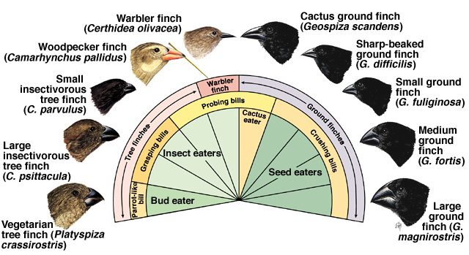
Darwin’s Theory of Evolution
The unequal ability of individuals to survive and reproduce leads to a gradual change in a population, with favorable characteristics accumulating over generations (natural selection)
New species evolve

Slide 27
Common Descent with Modification
Darwin proposed that organisms descended from common ancestors
Idea that organisms change with time, diverging from a common form
Caused evolution of new species

Slide 28
Descent With Modification
Species Today Look Different From Their Ancestors
Each Living Species Has
Descended
With Changes
From Other Species
Over Time

Slide 29
Descent With Modification
Implies
All Living Organisms Are Related
Single Tree of Life
DNA, Body Structures, Energy Sources
Common Descent
All Species, Living & Extinct, Were Derived From Common Ancestors

Slide 30
Publication of “On The Origin of Species”
He Refused To Publish Until He Received An Essay From Alfred Wallace
Fellow Naturalist
Independently Developed The Same Theory
After 25 Years, Someone Else Had Come To The Same Conclusions From Their Observations Of Nature

Slide 31
Natural Variation and Artificial Selection
Natural Variation
Differences Among Individuals Of A Species
Artificial Selection
Selective Breeding To Enhance Desired Traits Among Stock or Crops

Slide 32
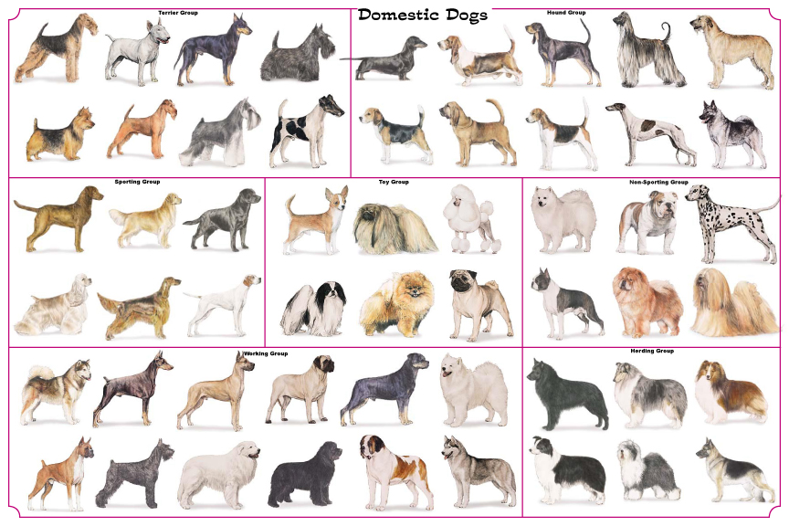

Slide 33
Survival of the Fittest
Fitness
Ability of an Individual To Survive & Reproduce
Adaptation
Inherited Characteristic That Increases an Organisms Chance for Survival

Slide 34
Survival of the Fittest
Adaptations Can Be:
Physical
Speed, Camouflage, Claws, Quills, etc.
Behavioral
Solitary, Herds, Packs, Activity, etc.

Slide 35
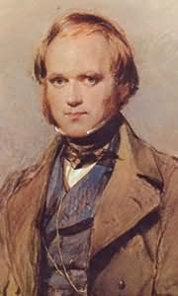
Major Problem in Darwin’s Theory
No mechanism to explain natural selection
How could favorable variations be transmitted to later generations?
With the rediscovery of Mendel’s work in the first half of the 20th century, the missing link in evolutionary theory was found
.

Slide 36
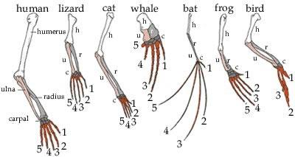
Homologous Structures

Slide 37
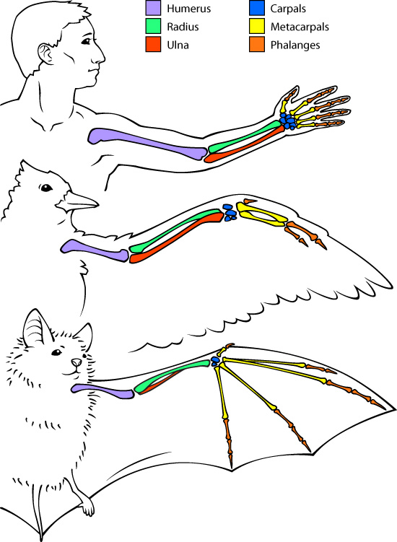

Slide 38
Homologous Body Structures
Scientists Noticed Animals With Backbones (Vertebrates) Had Similar Bone Structure
May Differ In Form or Function
Limb Bones Develop In Similar Patterns
Arms, Wings, Legs, Flippers

Slide 39
Homologous Body Structures
Structures That Have Different Mature Forms But Develop From The Same Embryonic Tissues
Strong Evidence That All Four-Limbed Animals With Backbones Descended, With Modification, From A Common Ancestor
Help Scientist Group Animals

Slide 40
Analogous Structures

Slide 41
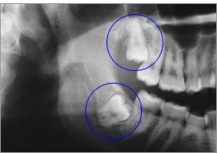
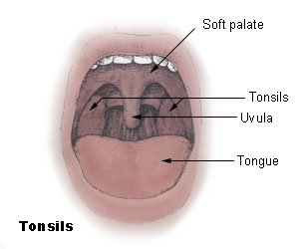
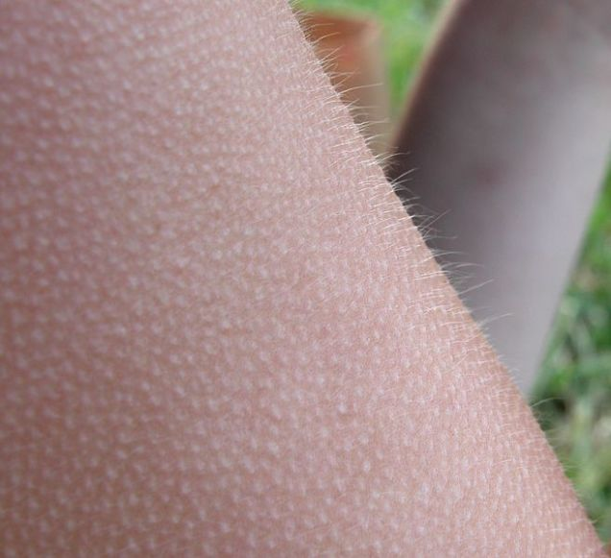
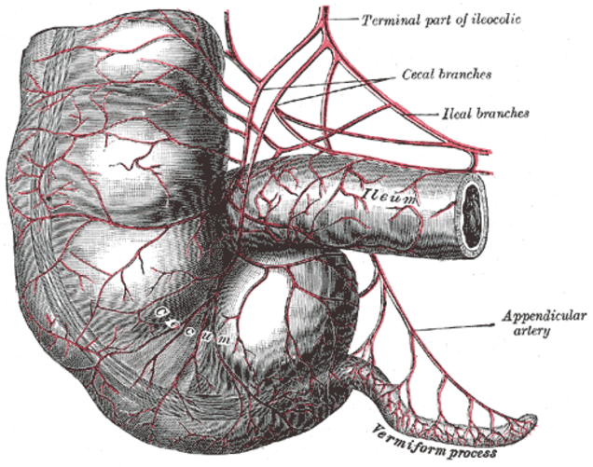
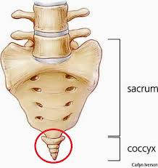
Vestigial Organs
Not All Serve Important Functions

Slide 42
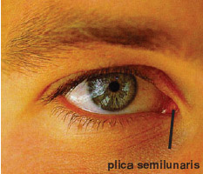
Plica Semilunaris

Slide 43
Palmarus longus
Palmar grasp reflex- 37%
Hiccup- amphibian respiration?

Slide 44
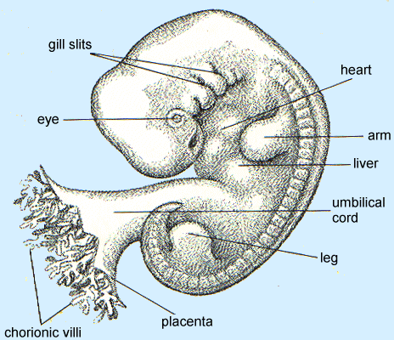
Human Fetus – 5 weeks

Slide 45
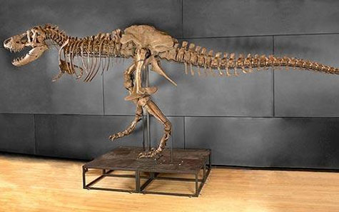
Fossil Evidence
Shows change over time of species
Only hard tissues are preserved.

Slide 46
tio

Slide 47
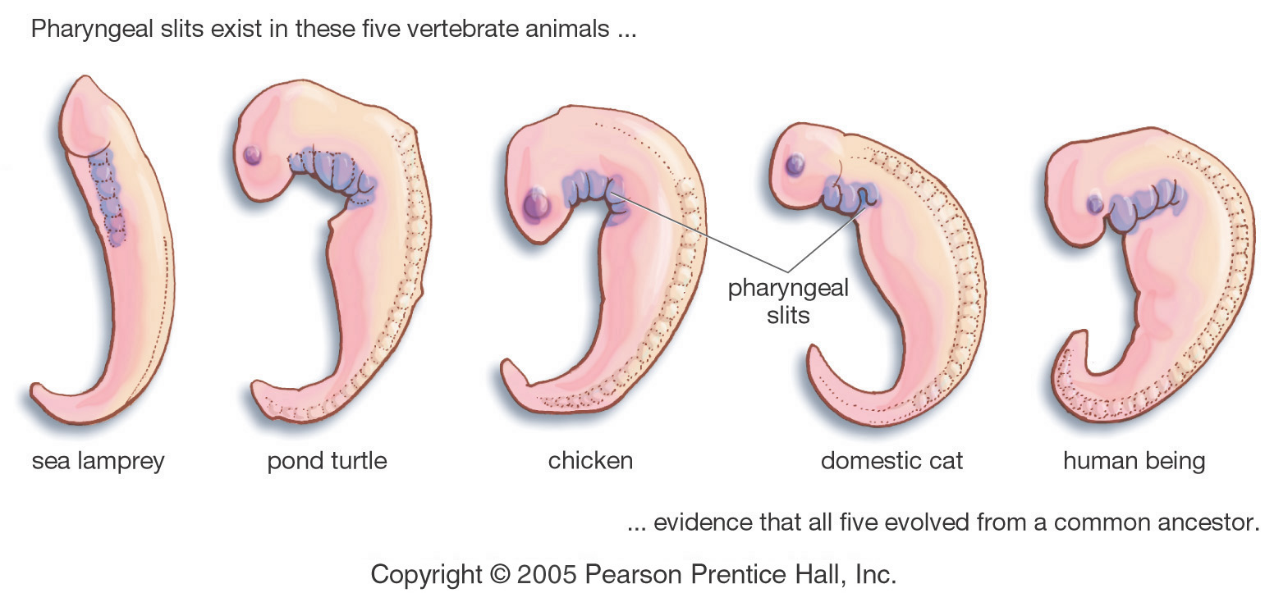
Evidence for Evolution - Comparative Embryology
Similarities In Embryonic Development

Slide 48
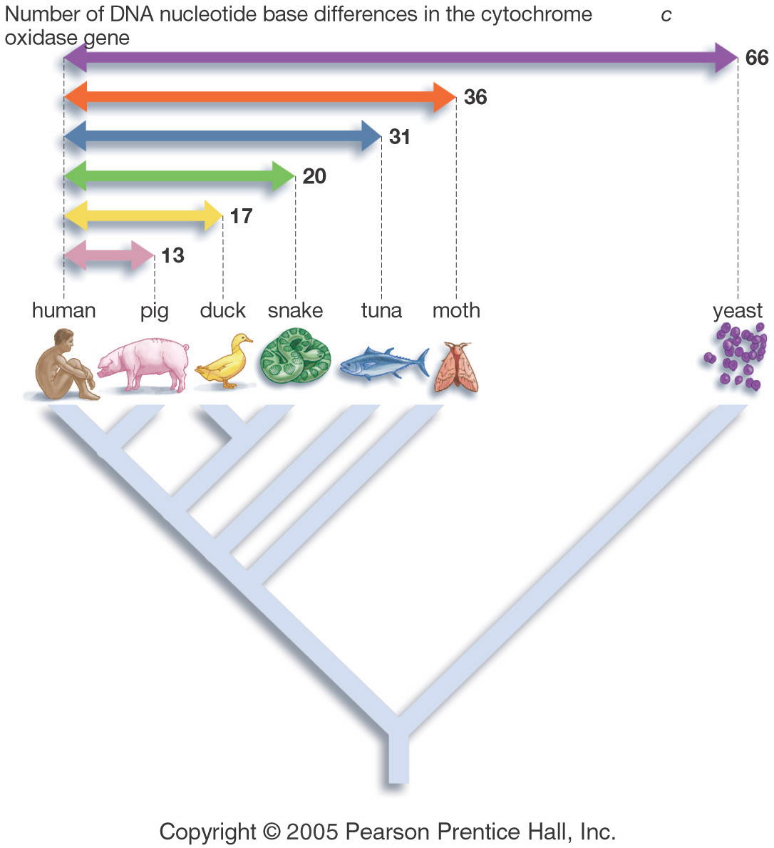
Similarities in DNA Sequence

Slide 49
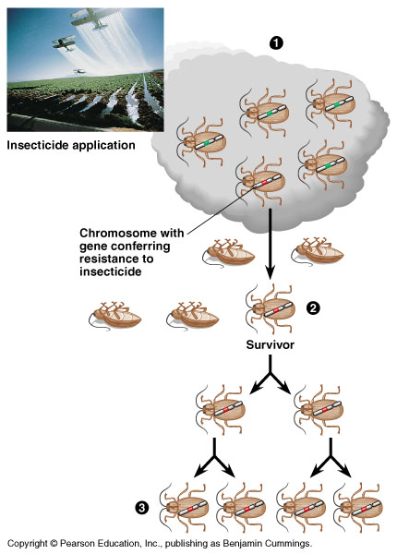
Evolution of pesticide resistance in response to selection

Slide 50
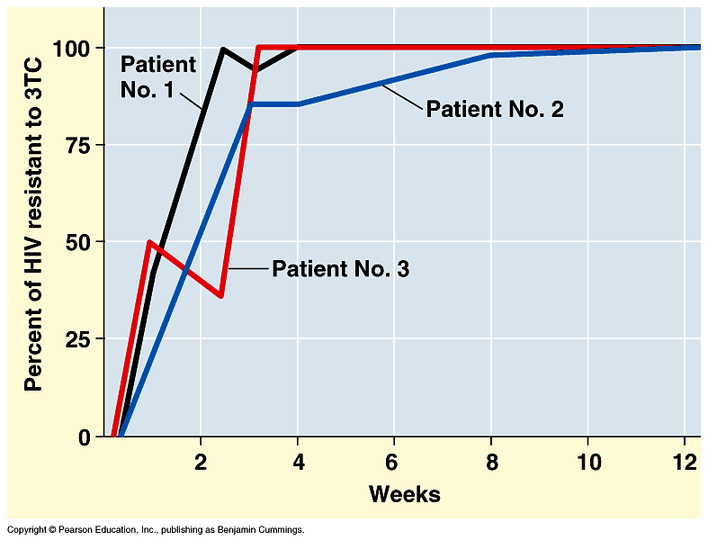
Evidence for Evolution – Evolution Observed
Evolution of drug-resistance in HIV

Slide 51
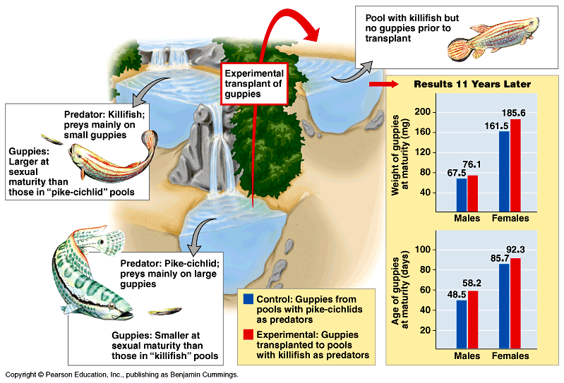
Evidence for Evolution – Evolution Observed
Selection against small guppies results in an increase in average size

Slide 52
Bell Work 12/5
Free write- Do you think humans could ever evolve to a different species? What might be a driving factor?
B-5.5 Exemplify scientific evidence in the fields of anatomy, embryology, biochemistry, and paleontology that underlies the theory of biological evolution.
B-5.6 Summarize ways that scientists use data from a variety of sources to investigate and critically analyze aspects of evolutionary theory.

Slide 53
zerbroid
Donkeys 62 chromosomes, zebras 46-52

Slide 54
Liger

Slide 55
Darwin's Theory
Individual Organisms In Nature Differ From One Another. Some Of This Variation Is Inherited
Organisms In Nature Produce More Offspring Than Can Survive, And Many Of These Offspring Do Not Reproduce

Slide 56
Darwin's Theory
Because More Organisms Are Produced Than Can Survive, Members Of Each Species Must Compete For Limited Resources
Because Each Organism Is Unique, Each Has Different Advantages & Disadvantages In The Struggle For Existence

Slide 57
Darwin's Theory
Individuals Best Suited To Their Environment Survive & Reproduce Successfully – Passing Their Traits To Their Offspring.
Species Change Over Time. Over Long Periods, Natural Selection Causes Changes That May Eventually Lead To New Species

Slide 58
Patterns of evolution
Does natural selection act directly on genes or on organisms?
Population- group of organisms of same species that reproduce.
Share a common gene pool. (allele frequency)
Evolution involves changes in allele frequencies over time.

Slide 59
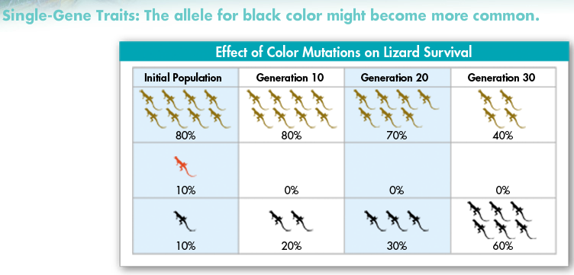
Patterns of evolution
Single gene traits- only one gene controls the phenotype.
Natural selection leads to changes in allele frequency and phenotype frequencies

Slide 60
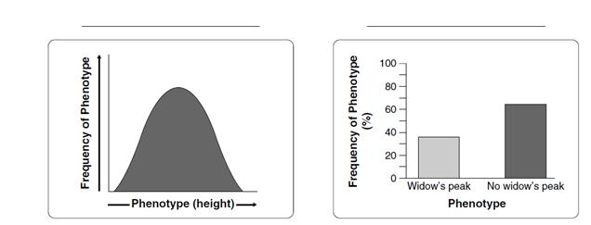
Patterns of evolution
Polygenic traits- Range of traits – bell curve of phenotypes.
Natural selection can affect their fitness and cause three different types of selection.

Slide 61
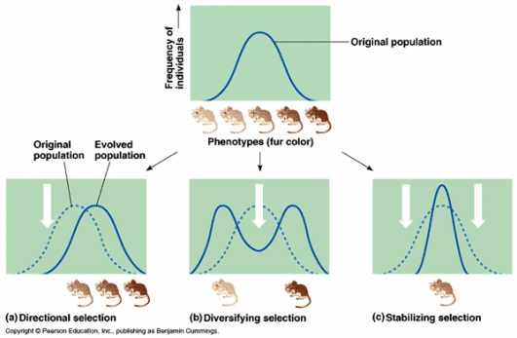
Types of selection

Slide 62
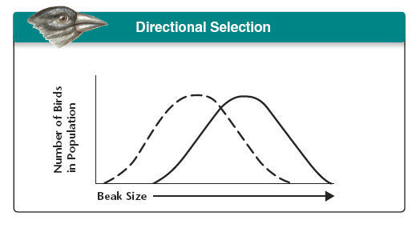
Directional- One end is more fit- shift of bell curve- still range of phenotypes

Slide 63
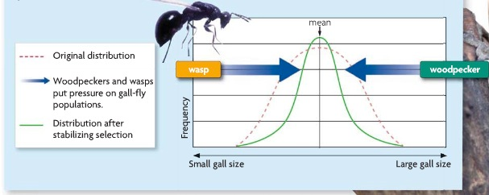
Stabilizing- Individuals near center have highest fitness. Curve narrows.

Slide 64
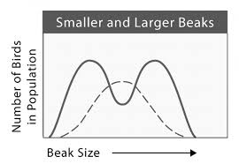
Disruptive-Individuals at either end have higher fitness. Increases diversity.

Slide 65
Genetic Drift
Random Change in allele frequency.
Natural selection is not the only thing that can change allele frequency.
In smaller populations, an individual with a particular allele may produce more offspring than others, increasing the frequency.
Decreases genetic diversity
Founder effect and genetic bottleneck.

Slide 66
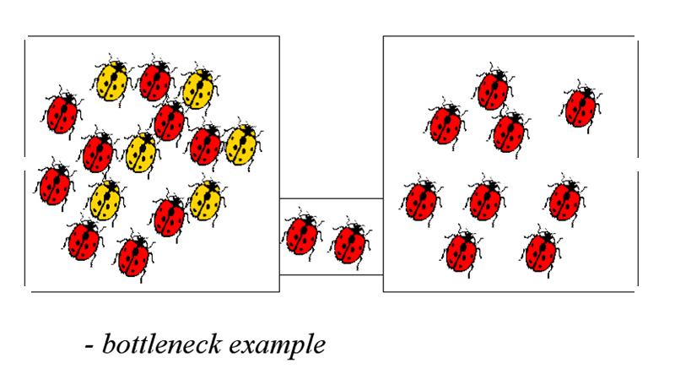
Genetic Bottleneck
Natural disaster can kill a large percent of the population, which could randomly change the allele frequencies.
Can decrease diversity.

Slide 67
Founder Effect
Occurs when a few individuals inhabit a new habitat.
May have an allele frequency much different than main population that they came from.
Ex. Amish populations in US
Marry within population and have come from a small subgroup.
Certain genetic diseases are more common than normal groups- polydactyly

Slide 68
Hardy Weinberg Principle
Allele frequencies in a population should remain constant unless one or more factors causes the frequency to change.
Like a Punnett square, but for populations.

Slide 69
Hardy Weinberg Principle
Frequency of AA + Aa + aa = 100%
P² +2pq + q² = 1
AND
Frequency of A + a = 100
If phenotype frequencies are not as predicted, evolution is happening.

Slide 70
Hardy Weinberg Principle
A genetic condition is controlled by two alleles, S and s which follow simple dominance. The condition only affects homozygous recessive individuals. The population is 10,000 and there are 36 individuals who have the disease. Use the HWE to find:
A: Freq of S and s allele. B: Freq of SS, Ss, and ss.
C: Carriers of disease

Slide 71
Hardy Weinberg Principle
Predicts 5 things can disturb genetic equilibrium and cause evolution
Nonrandom mating- “sexual selection” – pick mates based on heritable traits such as size, strength, coloration.
Small population size
Immigration/Emmigration “gene flow”
Mutations- can introduce new beneficial traits
Natural Selection- if different genotypes have different fitness.

Slide 72
Speciation
Species= population or group of populations that can interbreed and produce fertile offspring.
Reproductive isolationism – changes in gene pool can no longer spread together.

Slide 73
1. Reproductive Isolationism Prezygotic
Behavioral- two populations of a species develop different courtship rituals or behaviors.
Ex. Birds
Geographical- may separate species completely. Grand canyon squirrels
Temporal- species reproduce at different times of year.
Ex. Orchids in rain forest, only one day to pollinate. / trout

Slide 74
1. Reproductive Isolationism Postzygotic
Hybrid sterility- Survives, but cannot reproduce
Hybrid inviability

Slide 75
2. Behavioral Isolation
Two populations that are capable of interbreeding but develop different courtship rituals or behaviors.
https://www.youtube.com/watch?v=bbLpZn4B7b0

Slide 76
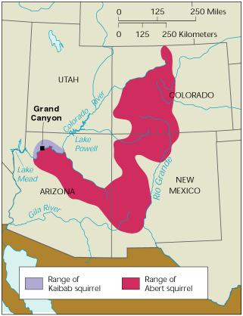
3. Geographic Isolation

Slide 77
4. Temporal Isolation

Slide 78
6 Patterns of speciation

Slide 79
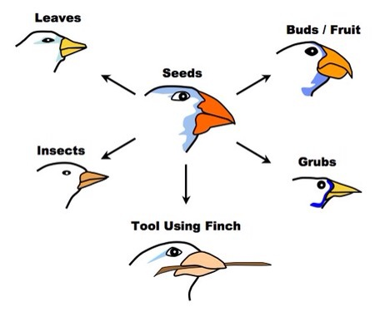
6 Patterns of speciation
3. Divergent evolution- species that were once similar become increasingly different from each other.
As they adapt
to different
environments.

Slide 80
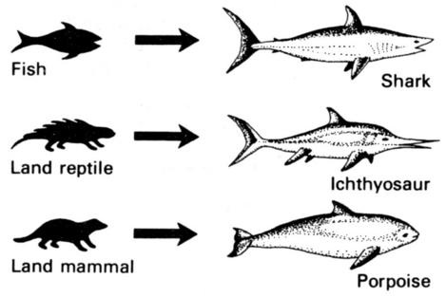
6 Patterns of speciation
4. Convergent evolution- species that do not share common ancestor, but evolve similar characteristics.

Slide 81
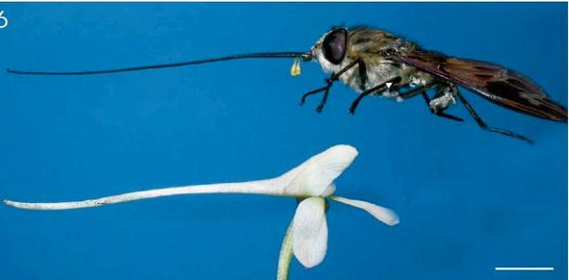
6 Patterns of speciation
5. Coevolution- two or more species living in same environment evolve with each other.

Slide 82
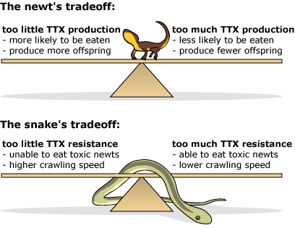
Newt and snake coevolution

Slide 83
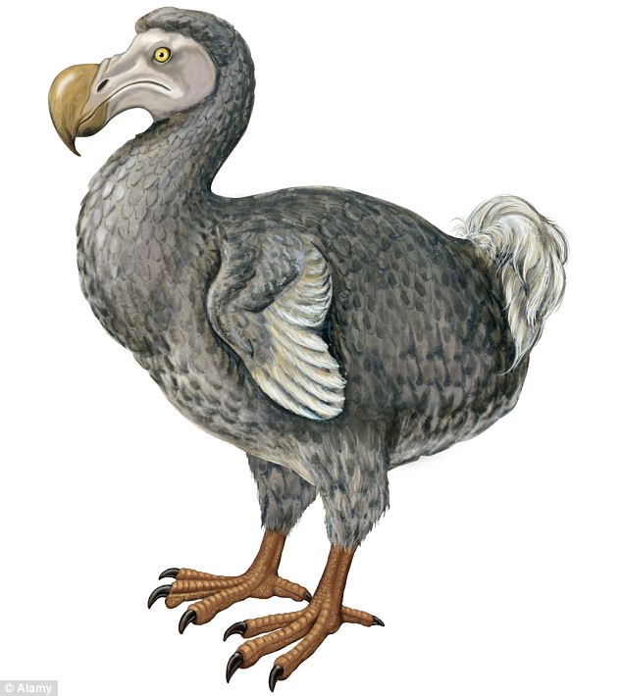
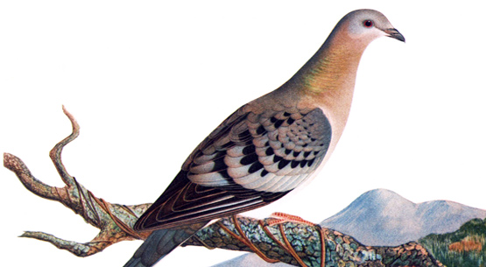
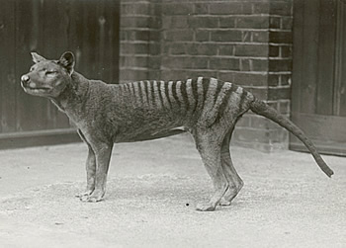
6 Patterns of speciation
Extinction

Slide 84
Polyploidy
Meiosis disorders that can result in 2n gametes instead of n. zygote is 4n = new species
Mostly plants
Results in sterility.
BANANA, WATERMELON= 3N
Strawberry, sugar cane = 8n
Apples, potatoes, 4n
.

