Slide 1
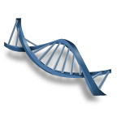
Cell Cycle, DNA, and Protein Synthesis

Slide 2
Bell Work 10/21
What are the two ways that cells can grow?
Objective H.B.2D.2 : Show the changes that occur in a cell during the cell cycle (including changes in cell size, chromosomes, cell membrane/cell wall, and the number of cells produced) and predict, based on the models, what might happen to a cell that does not progress through the cycle correctly.

Slide 3
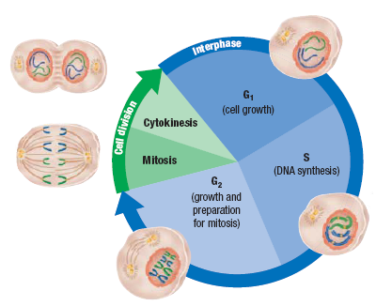
The Cell Cycle (see diagram on page 228)
G1 – GAP 1 – Chromosomes are not visible (chromatin) Cell is rapidly growing and synthesizing proteins for daily functions
Mitosis - Cell divides the nucleus followed by cytoplasm division (cytokinesis) resulting in two identical daughter cells
G2 – Gap 2 - Cell is growing and producing proteins needed for mitosis
S Stage - Synthesis
Chromosomes are replicated to form a pair of sister chromatids connected by a centromere

Slide 4
Cell Division
All cells are derived from pre-existing cells
New cells are produced for growth and to replace damaged or old cells
Differs in prokaryotes (bacteria) and eukaryotes (protists, fungi, plants, & animals)

Slide 5
DNA Replication
DNA must be copied or replicated before cell division
Each new cell will then have an identical copy of the DNA
Original DNA strand
Two new, identical DNA strands

Slide 6
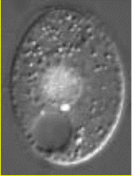
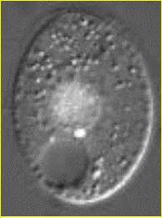
Identical Daughter Cells
Two identical daughter cells
Parent Cell

Slide 7
Chromosomes

Slide 8
Prokaryotic Chromosome
The DNA of prokaryotes (bacteria) is one, circular chromosome attached to the inside of the cell membrane

Slide 9
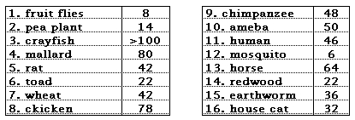
Do more chromosomes mean a more complex organism?

Slide 10
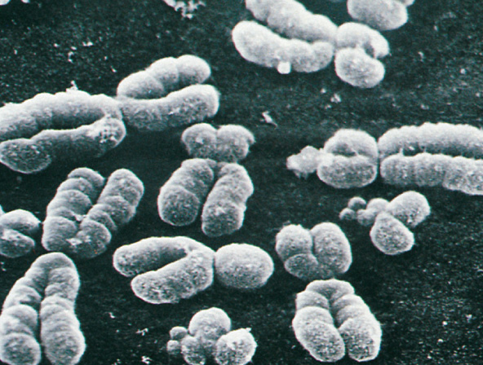
Eukaryotic Chromosomes
All eukaryotic cells store genetic information in chromosomes
Most eukaryotes have between 10 and 50 chromosomes in their body cells
Human body cells have 46 chromosomes or 23 identical pairs

Slide 11
Eukaryotic Chromosomes
Each chromosome is composed of a single, tightly coiled DNA molecule
Chromosomes can’t be seen when cells aren’t dividing and are called chromatin

Slide 12
Compacting DNA into Chromosomes
DNA is tightly coiled around proteins called histones

Slide 13
Chromosomes in Dividing Cells
Duplicated chromosomes are called chromatids & are held together by the centromere
Called Sister Chromatids

Slide 14
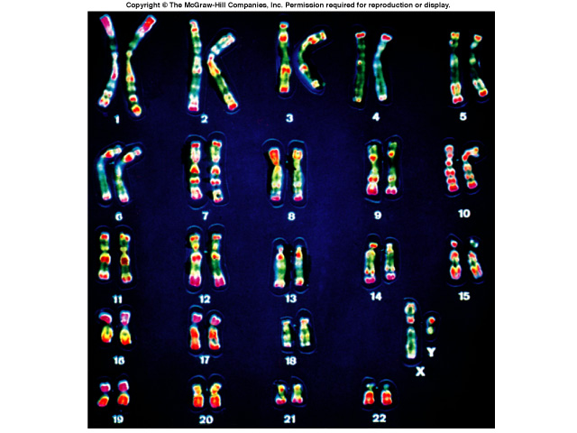
Karyotype
A picture of the chromosomes from a human cell arranged in pairs by size
First 22 pairs are called autosomes
Last pair are the sex chromosomes
XX female or XY male

Slide 15
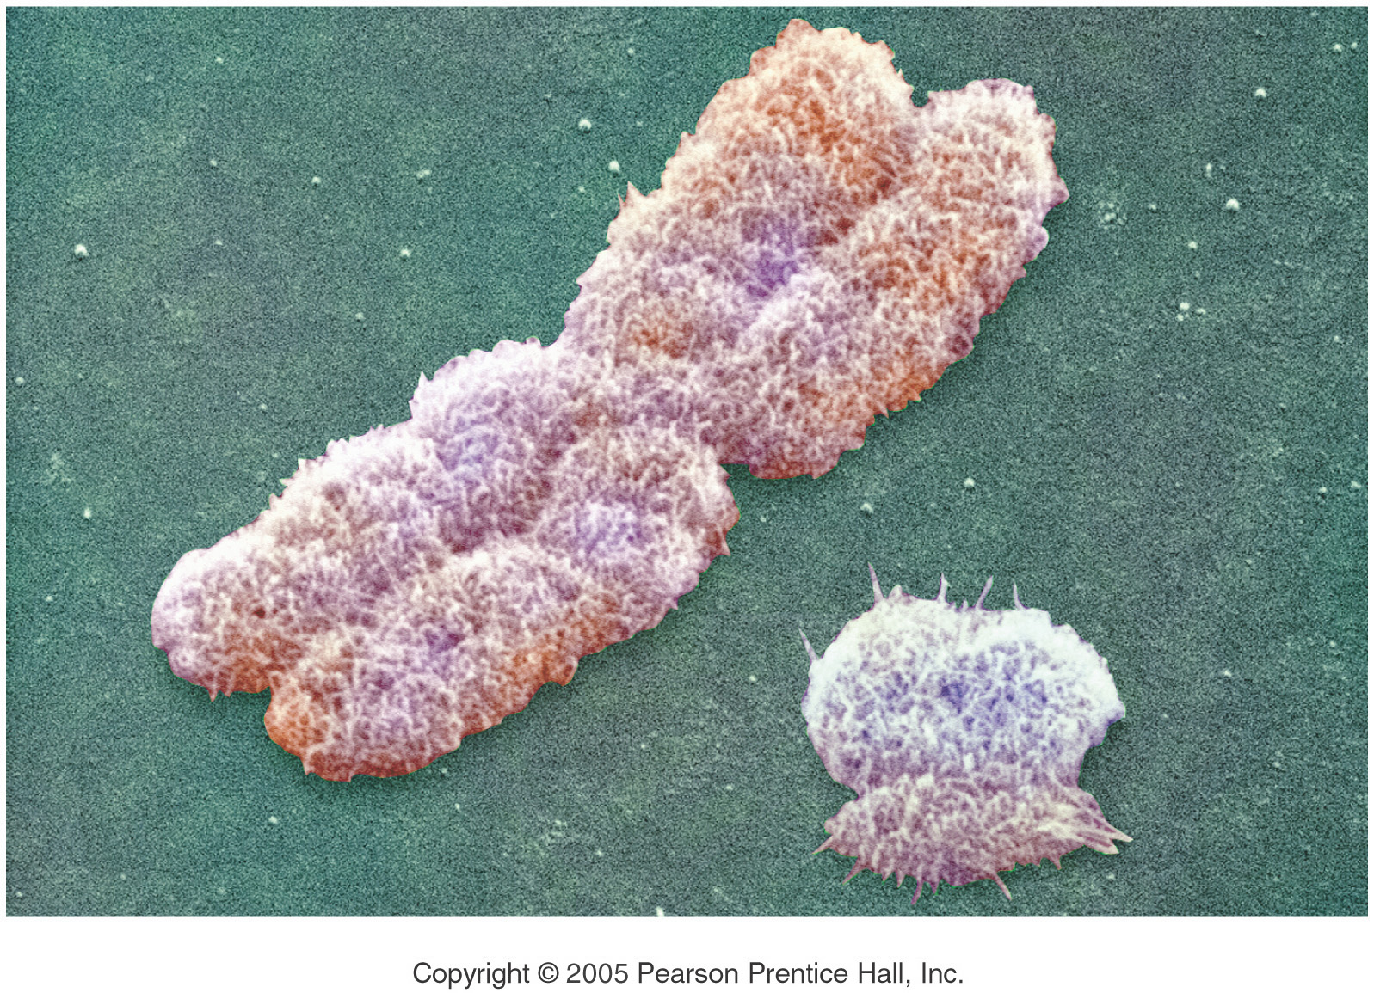
Boy or Girl?
The Y Chromosome Decides
Y - Chromosome
X - Chromosome

Slide 16
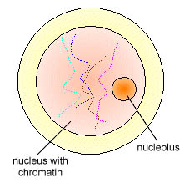
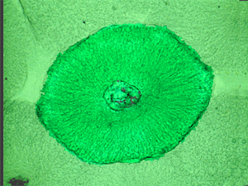
The Cell Cycle
We have learned that the basic unit of life is the cell.
Like all living things, the cell goes through a cycle of growth and reproduction.
The sequence of growth and division of a cell is called the Cell Cycle.
Most of the cell’s life is spent in the growth phase known as interphase

Slide 17
The Cell Cycle (see diagram on page 228)
G1 – GAP 1 – Chromosomes are not visible (chromatin) Cell is rapidly growing and synthesizing proteins for daily functions
Mitosis - Cell divides the nucleus followed by cytoplasm division (cytokinesis) resulting in two identical daughter cells
G2 – Gap 2 - Cell is growing and producing proteins needed for mitosis
S Stage - Synthesis
Chromosomes are replicated to form a pair of sister chromatids connected by a centromere

Slide 18
Mitosis
During mitosis, one parent cell divides into two identical daughter cells.
All somatic cells (cells other than the sex cells that make eggs and sperm) undergo mitosis.
There are four phases of mitosis:
Prophase
Metaphase
Anaphase
Telophase

Slide 19
Prophase
This is the first and longest phase in mitosis.
The nuclear envelope disappears
Chromatin coils to become visible chromosomes
The two halves of the doubled structure are called sister chromatids.
Sister chromatids are exact copies of each other ande ar held together by a centromere.
In animal cells, the centrioles move to opposite ends of the cell and start to form spindle fibers

Slide 20
Metaphase
The second and shortest phase in mitosis
The spindle fibers attach to the centromere
The sister chromatids are then pulled to the middle of the cell and line up on the midline or equator
One sister chromatid from each pair points to one pole while the other points to the opposite pole

Slide 21
The Spindle

Slide 22
Anaphase
The centromeres split and the sister chromatids are pulled to opposite poles of the cell

Slide 23
Telophase
Chromosomes uncoil
Spindle is broken down
Nuclear envelope reappears
Cytokinesis begins

Slide 24
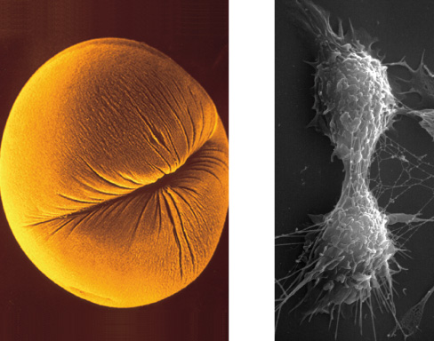
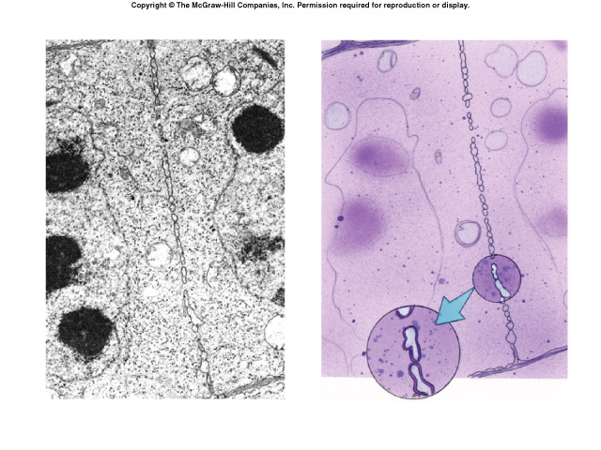
Cytokinesis
Cleavage furrow in animal cell
Cell plate in animal cell

Slide 25
Cytokinesis
Cytoplasm is split forming two daughter cells each with its own nucleus and cytoplasmic organelles
In animals: a cleavage furrow is formed that pinches the two cells apart
In plants: a cell plate forms between the two new cells to start the formation of the cell wall (this does not occur in animal cells!)
Cell Plate

Slide 26
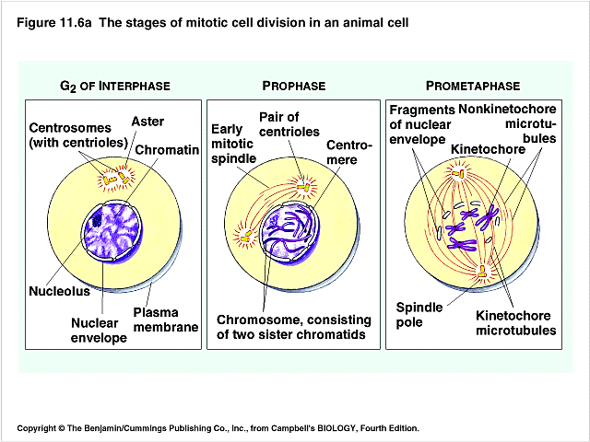
Draw & Learn these Stages

Slide 27
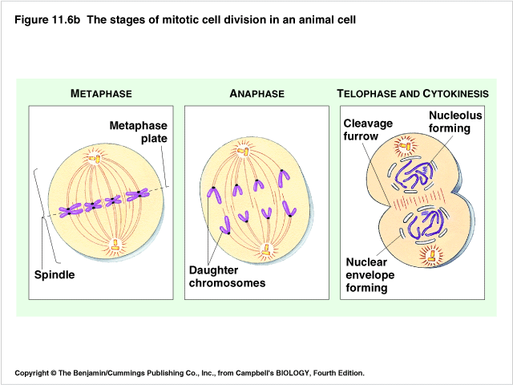
Draw & Learn these Stages

Slide 28
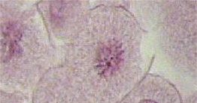
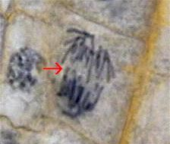
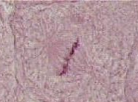
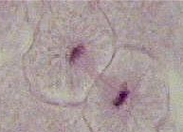
Name the Phase
Prophase
Anaphase
Prophase
Metaphase
Metaphase
Telophase
Telophase
Anaphase

Slide 29
Identify the Stages
?
Early, Middle, & Late Prophase
?
?
?
Metaphase
Anaphase
Late Prophase
?
?
?
Late Anaphase
Telophase
Telophase & Cytokinesis

Slide 30
Controlling the Cell Cycle
The cell cycle is driven by a chemical control system telling the cell when to turn on and off cell division
Internal signals – cell senses the presence of enzymes produced within the cell
External signals – cell senses the presence of chemicals (such as growth factors) produced by other specialized cells
Cells also respond to physical signals
When cells are packed in too closely, division is turned off
When cells are not in contact with other cells, division is turned on

Slide 31
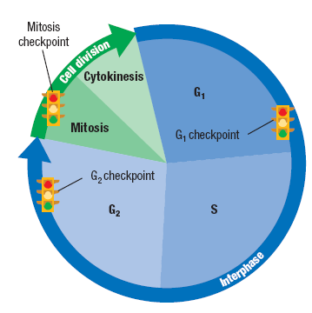
Controlling the Cell Cycle
The cycle control system is regulated at certain checkpoints
At each checkpoint, the cell decides if it should go on with division
G1 – makes sure conditions are favorable and cell is big enough for division
G2 – cell checks for any mistakes in the copies of DNA
Mitosis – cell makes sure chromosomes and spindle are arranged properly
Specific stimuli are required to initiate cell division. Cell division in most animal’s cells is in the “off” position when no stimulus is present

Slide 32
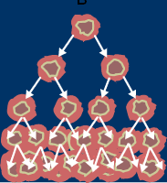
Mitosis Out of Control
Cancer cells are an example of cells that do not listen to the cell’s control system
Cancer cells keep dividing even though they may be closely packed together or no growth factor is present.
Cancer begins as a single cell
This cell is normally found and destroyed by the body’s immune system. If not, this cell could divide into a mass of identical daughter cancer cells that:
Impair the function of one or more organs – malignant tumor
Cells can break off, enter the blood and lymph systems and invade other parts of the body and become new tumors.
Remain at their original site – benign tumor

Slide 33
Apoptosis
“Programmed cell death”
Basically break the cell membrane to release the contents.
Nearby cells will clean up the remaining parts of the cell.
AIDS and Parkinson’s disease are associated with inappropriate apoptosis in cells.

Slide 34
Cancer
Cells lose ability to control growth causing rapid uncontrolled mitosis.
Tumors – mass of cells
Benign- does not spread to nearby tissue
Malignant – Spreads to other tissues
Absorb nutrients, block nerve connections, and prevent proper organ function.
Often caused by defects in genes that regulate cell growth.
Can be caused by smoking, radiation, viral infections, etc.

Slide 35
Cancer Treatments
Surgery- Cut out localized tumors (skin cancer)
Chemotherapy – drugs that target fast growing cells
Radiation therapy – targets the gap phase of cellular growth

Slide 36
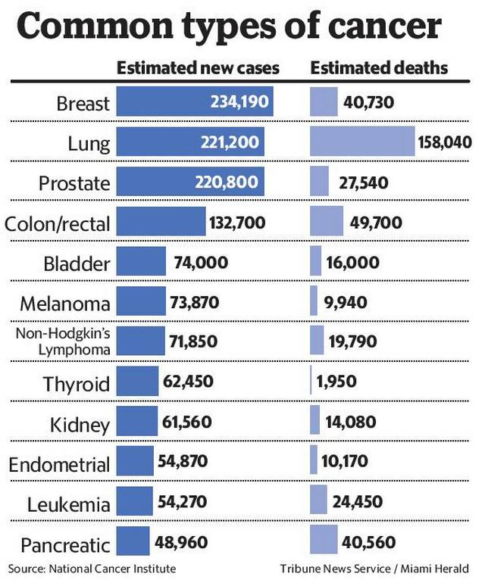

Slide 37
Cell Differentiation
100,000,000,000,000 100 trillion cells
Hundreds of unique types of functions in the human body
Stem cells – undifferentiated cells ( have the ability to be different types)
Pluripotent- (embryonic stem cells ) can become any different type of tissue
Multipotent (adult stem cells) can become more than one type of cell , but are limited to replacing the cells in the tissues they are found ( ex. Muscle, bone, brain)

Slide 38
Ethical Issues
Adult stem cells – harvested directly from willing donor, few issues ethically.
Embryonic stem cells – destroy the embryo by obtaining the cells.
Induced pluripotent stem cells – tailor specific treatments to a patient by converted a fibroblast to resemble embryonic stem cells .

